Slide 1
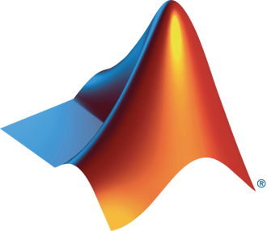

University and MathWorks Present: Optimization Onramp

Slide 2
Today:
6:15 pm – 6.30 pm: Set-up
Intro to Optimization
Create MathWorks account
Log in to Optimization Onramp / Test MATLAB Online
6.30 pm – 8.00 pm: Optimization Onramp (on your own)

Slide 3

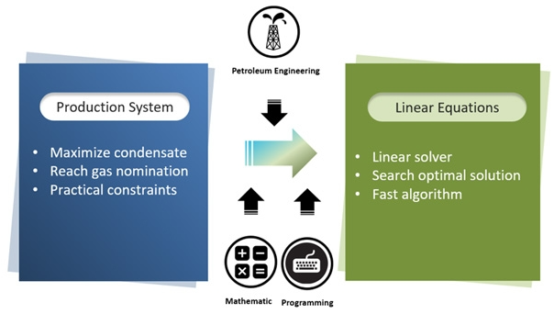
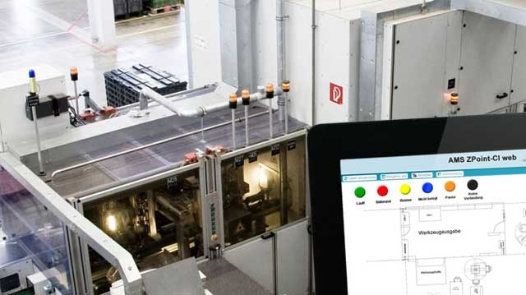
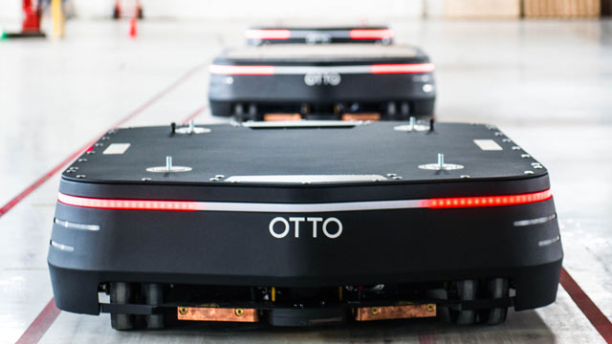

What can you do with optimization?
BuildingIQ: Reduce energy consumption
Realtek: Optimize designs
PTTEP: Plan gas field production
STIWA: Optimize trajectories
Clearpath Robotics: Minimize travel distance
Tessella: Minimize propellant consumption
Notes:
Examples of optimization from our users.
BuildingIQ reduces HVAC energy consumption by 10–25% during normal operation
Realtek Semiconductor used Signal Processing Tbx & Optim Tbx to transfer the product concept into a workable model.
PTTEP used MATLAB® and Optimization Toolbox™ to develop software that maximizes gas field production and generates accurate medium-term and long-term production forecasts while accounting for strict operational constraints
STIWA algorithms invoke Optimization Toolbox™ functions to calculate optimal trajectories based on defined constraints, including velocity and space limitations.
OTTO used MATLAB to develop fleet management algorithms that use agent-based modeling to guide a group of OTTO robots as they work together to complete missions. The team used Optimization Toolbox to minimize specific metrics—for example, completing the mission in the shortest time or within the shortest distance travelled by the robots.
Tessella - The engineers on the Solar Orbiter used Optimization Toolbox™ to optimize this thruster commanding algorithm and minimize propellant consumption while operating within the physical constraints of the thrusters.

Slide 4
Design Process
Modify Design Variables
No
Initial Design Variables
System
Yes
Objectives
met?
Optimal Design
Notes:
For a design problem…
Feed initial guess of design variables to system, check result
If objectives weren’t met, we need a way of modifying the design variables
This is what optimization routines are really good at, they use information gathered from running the system to make educated decisions about how to modify the design variables in order to improve the system
Closed loop process that can be iterated on until the objectives are met

Slide 5
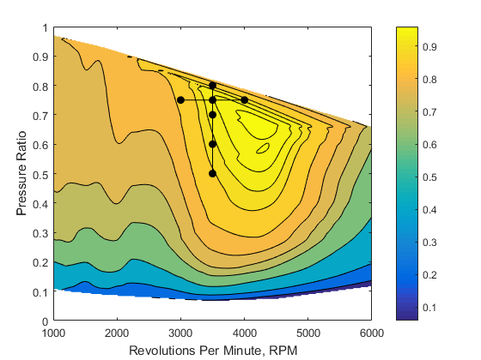
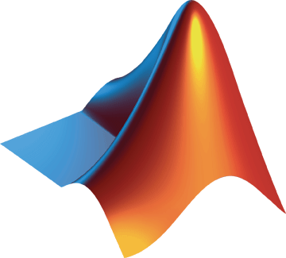
Why use Optimization?
Manually (trial-and-error or iteratively)
Initial Guess
Notes:
First, going to show how I would go about optimizing a system if I didn’t have an optimization routine.
The plot is from an automotive engine and shows how the fuel efficiency, measured by the colors, is effected by the engine rotation speed, in rpm, and the intake pressure ratio.
Want to maximize fuel efficiency
Let’s imagine though that I don’t have this map available, possibly because it would simply take too long to run my system at each point required to generate this plot.
Start with initial guess, adjust pressure ratio (one factor at a time)
Reach a better point by adjusting pressure ratio, then hold pressure ratio fixed and adjust engine speed
As you can see from this t-shaped search pattern, we end up at a better result than we started, but we were unable to find the maximum fuel efficiency.
I showed this type of approach to raise the question “how do you know you’ve come to the best solution to your problems?”
This type of approach is very common, especially when you take into account the cost of testing.
So how can we use optimization techniques to help us find the best solution?

Slide 6
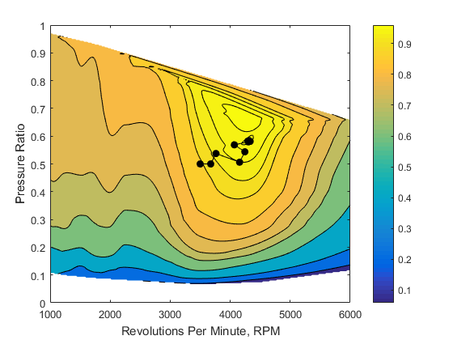
Why use Optimization?
Automatically (using optimization techniques)
Initial Guess
Notes:
First, going to show how I would go about optimizing a system if I didn’t have an optimization routine.
The plot is from an automotive engine and shows how the fuel efficiency, measured by the colors, is effected by the engine rotation speed, in rpm, and the intake pressure ratio.
Want to maximize fuel efficiency
Let’s imagine though that I don’t have this map available, possibly because it would simply take too long to run my system at each point required to generate this plot.
Start with initial guess, adjust pressure ratio (one factor at a time)
Reach a better point by adjusting pressure ratio, then hold pressure ratio fixed and adjust engine speed
As you can see from this t-shaped search pattern, we end up at a better result than we started, but we were unable to find the maximum fuel efficiency.
I showed this type of approach to raise the question “how do you know you’ve come to the best solution to your problems?”
This type of approach is very common, especially when you take into account the cost of testing.
So how can we use optimization techniques to help us find the best solution?

Slide 7
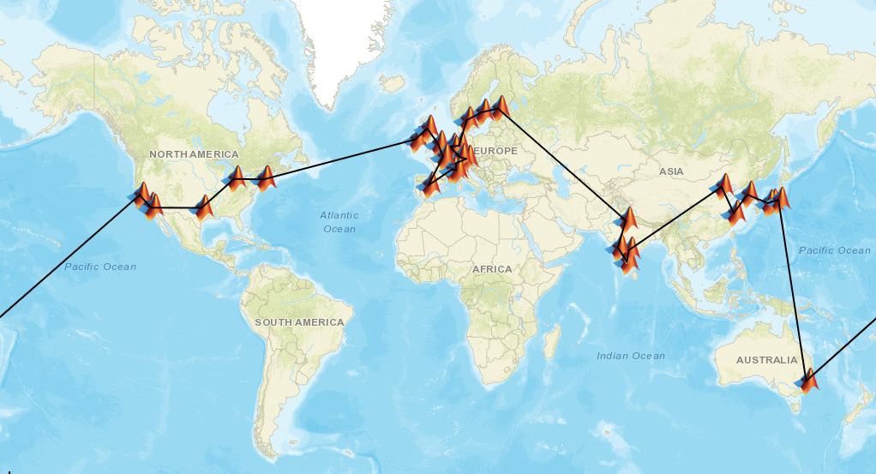
Why use Optimization?
Choose the optimal route to visit all MathWorks offices
34 offices
561 trips from one office to another
8.6833e+36 ways to assemble trips into a tour
Finding the optimal tour using mixed-integer linear programming takes about a minute
Notes:
A decision problem
Impossible for a human to consider all the possible tours!
We can use integer linear programming to find the optimal tour
Example of an integer programming optimization problem
MATLAB Optimization Toolbox solves this in about a minute
Example available, but usually just present the slide.
https://insidelabs-git.mathworks.com/AE-Content/demos/TravelingSalesman

Slide 8
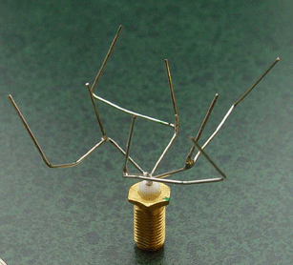
Why use Optimization?
Finding better (optimal) designs and decisions
Faster design and decision evaluations
Useful for trade-off analysis
Non-intuitive designs may be found
Automate routine decisions
Antenna Design Using Genetic Algorithm
http://ic.arc.nasa.gov/projects/esg/research/antenna.htm
Notes:
Other benefits include:
Faster design and decision evaluations due to the automation of the search
Can replaces manual decision processes with automated ones, especially for routine tasks, for example, selecting the shortest route for a set of deliveries
and optimization can be used to evaluate trade-offs in many dimension, which become extremely difficult to manage and can be costly when an iterative or trial-and-error approach are used
One final benefit is that optimization can lead to non-intuitive designs, as solvers may find a solution you hadn’t previously considered. An example of this is the antenna design shown here, which was found using Genetic Algorithms. The solution doesn’t look like any antenna design that I’ve seen before.

Slide 9
How can optimization be used in the real world?

Slide 10

ABB, Deltamarin, and VTT Simulate and Optimize Ship Energy Flows
Challenge
Increase the energy efficiency of new and existing cruise ships, container ships, and other large vessels
Solution
Use Simulink and Simscape to model, simulate, and optimize ship energy flow at the system level
Results
System-level ship energy optimization enabled
Cost- and fuel-saving design improvements identified
Testing costs reduced by tens of thousands of euros
Cruise vessel. The simulator built by ABB, Deltamarin, and VTT enables engineers to design and optimize energy flows for large ships such as this.
“Simulink and Simscape enabled us to create a dynamic model of a complex energy system that spans several physical domains. By simulating this model, we can see how a new energy subsystem will perform before it is built, and provide customers with an accurate estimate of their return on investment.”
- Juha Orivuori, ABB
Link to user story
Notes:
Industries: Energy production, Rail, ships, and other transportation
Application Areas: Control systems
Capabilities: Data analysis, Mathematical modeling, System design and simulation, Physical modeling
Products Used: MATLAB, Simulink, Simscape
Country: Finland
ABB, Deltamarin, and VTT Simulate and Optimize Ship Energy Flows
Rising fuel costs and tightening International Maritime Organization (IMO) regulations have sparked demand for more powerful ship energy systems that use less fuel.
To help meet this demand, ABB, Deltamarin, and VTT Technical Research Centre of Finland partnered to build a ship energy flow simulator using MATLAB®, Simulink®, and Simscape™. The simulator enables engineers to test, evaluate, and implement novel technologies with fewer prototypes, as well as to design and retrofit optimized energy systems based on customer requirements and ship operating profiles.
“It is practically impossible to prototype a major energy subsystem for today’s vessels—it takes too long and is too expensive,” says Juha Orivuori, lead development engineer at ABB. “Simulink and Simscape enable us to simulate each individual subsystem as part of a complete ship energy system so that we know how it will work before we implement it.”
Challenge
Increasing a ship’s cargo capacity can reduce unit operating costs, but larger ships require more complex power plants with more sophisticated mechanical, electrical, hydraulic, and thermohydraulic subsystems. Because the behavior of these subsystems is interdependent, improving the performance of one subsystem may actually reduce overall efficiency. As a result, selecting and dimensioning propulsion, main power systems, all the auxiliaries, and cooling and heating for new and existing ships is a challenging optimization problem.
In the past, engineers used spreadsheets to calculate ranges for component sizes, but they found several drawbacks with this approach. The spreadsheets were not always reusable across projects, and colleagues found them difficult to review and understand. The approach was impractical for analyzing the system at various ship speeds and drafts or under wind, sea state, and other operating conditions. Spreadsheets were not suitable for dynamic analysis, and they could not be compared with data measured at sea or used to develop control systems.
To understand and identify interactions between different subsystems, Deltamarin, ABB, and VTT needed to model the complete ship energy flow with mechanical, electrical, hydraulic, thermal, pneumatic, and thermohydraulic components. They then needed to simulate this multidomain physical model to perform system-level optimizations.
“Simulink and Simscape enabled us to create a dynamic model of a complex energy system that spans several physical domains. By simulating this model, we can see how a new energy subsystem will perform before it is built, and provide customers with an accurate estimate of their return on investment.”
- Juha Orivuori, ABB
Solution
A small team of engineers from ABB, Deltamarin, and VTT built the ship energy flow simulator using Simulink and Simscape. Working in Simulink, the team created a top-level model incorporating the main engine, diesel generator, electric alternating current (AC), propeller, cooling water, and steam subsystems.
The team developed component models based on first principles using Simscape blocks from the mechanical, electrical, thermal, pneumatic, and hydraulic domains. They used measurements taken from actual ship systems to set parameter values in the models and validate simulation results.
“One advantage of creating the models based on first principles is that the models are easy to understand,” says Guangrong Zou, research scientist at VTT. “We can clearly see how well a Simscape model is working even if we do not have measurements to fully validate it.”
Using the Simscape language, they defined three custom physical domains—thermalfluid, steam, and electrical AC—and built libraries of new Simscape components based on those domain definitions, including a new thermalfluid library with more than 50 components.
The team developed MATLAB scripts to automate model configuration and simulation runs. They also used MATLAB to generate plots and postprocess simulation results.
To meet the needs of ship designers who use spreadsheets to perform energy balance equations, the team built an interface to the simulator that enables designers to provide simulation inputs and review simulation outputs in Microsoft® Excel®.
The group has modeled and performed energy flow simulations for cruise ships, container ships, and other ship types, and ABB is using the simulator with its onboard Energy Monitoring and Management (EMMA™) system to understand the efficiency of existing vessels.
Results
■ System-level ship energy optimization enabled. “While basic machinery can be modeled in spreadsheets, we could not achieve all our goals in Excel,” says Mia Elg, development manager at Deltamarin. “Simulink and Simscape enable us to run multidomain simulations and energy balance calculations with dynamic operating profiles and to perform energy optimization for today’s ships and future ships.”
■ Cost- and fuel-saving design improvements identified. “Simulink simulations showed that the main water cooling pump was not optimally dimensioned or controlled, and that design changes to this pump alone could reduce a ship’s annual fuel consumption by 2.5%,” says Elg. Zou adds, “This is only the beginning of the savings in the machinery auxiliary systems: Simulations showed that control optimizations for a three-way valve resulted in up to 45% more heat energy recovered.”
■ Testing costs reduced by tens of thousands of euros. “When we are testing a new system on a vessel, the daily costs can be significant,” says Orivuori. “With Simulink and Simscape we find and fix problems via simulation—in a virtual lab at no extra cost—that would be very expensive to resolve aboard a vessel.”
Project Team
ABB: Juha Orivuori, lead development engineer, and Kalevi Tervo, lead development engineer
Deltamarin: Mia Elg, development manager, and Su Len Quach, energy and environmental efficiency, concept development
VTT: Kari Tammi, research professor and research manager; Aki Kinnunen, senior scientist; and Guangrong Zou, research scientist
Learn more about ABB: www.abb.com
Learn more about Deltamarin: www.deltamarin.com
Learn more about VTT: www.vtt.fi

Slide 11
BuildingIQ Develops Proactive Algorithms for HVAC Energy Optimization in Large-Scale Buildings
Challenge
Develop a real-time system to minimize HVAC energy costs in large-scale commercial buildings via proactive, predictive optimization
Solution
Use MATLAB to analyze and visualize big data sets, implement advanced optimization algorithms, and run the algorithms in a production cloud environment
Results
Gigabytes of data analyzed and visualized
Algorithm development speed increased tenfold
Best algorithmic approaches quickly identified
Large-scale commercial buildings can reduce energy costs by 10–25% with BuildingIQ’s energy optimization system.
“MATLAB has helped accelerate our R&D and deployment with its robust numerical algorithms, extensive visualization and analytics tools, reliable optimization routines, support for object-oriented programming, and ability to run in the cloud with our production Java applications.”
- Borislav Savkovic, Building IQ
Link to user story
Notes:
Industries: Energy production
Application Areas: Data analytics, Control systems
Capabilities: Data analysis, Mathematical modeling, Algorithm development, Machine learning
Products Used: MATLAB, Control System Toolbox, Optimization Toolbox, Signal Processing Toolbox, Statistics and Machine Learning Toolbox
Country: Australia
BuildingIQ Develops Proactive Algorithms for HVAC Energy Optimization in Large-Scale Buildings
Office buildings, hospitals, and other large-scale commercial buildings account for about 30% of the energy consumed worldwide. The heating, ventilation, and air-conditioning (HVAC) systems in these buildings are often inefficient because they do not take into account changing weather patterns, variable energy costs, or the building’s thermal properties.
BuildingIQ has developed Predictive Energy Optimization™ (PEO), a cloud-based software platform that reduces HVAC energy consumption by 10–25% during normal operation. PEO was developed in cooperation with the Commonwealth Scientific and Industrial Research Organisation (CSIRO), Australia’s national science agency. Its advanced algorithms and machine learning methods, implemented in MATLAB®, continuously optimize HVAC performance based on near-term weather forecasts and energy cost signals.
“CSIRO used MATLAB to develop the initial technology. We continue to use MATLAB because it is the best tool available for prototyping algorithms and performing advanced mathematical calculations,” says Borislav Savkovic, lead data scientist at BuildingIQ. “MATLAB enabled us to transition our prototype algorithms directly into production-level algorithms that deal reliably with real-world noise and uncertainty.”
Challenge
BuildingIQ needed to develop algorithms that could continuously process gigabytes of information from a variety of sources, including power meters, thermometers, and HVAC pressure sensors, as well as weather and energy cost data.
A single building often produces billions of data points, and the scientists and engineers needed tools for efficiently filtering, processing, and visualizing this data.
To run their optimization algorithms, the scientists and engineers had to create an accurate mathematical model of a building’s thermal and power dynamics. The algorithms would use this calculated model to run constrained optimizations that maintained occupant comfort while minimizing energy costs.
BuildingIQ needed a way to rapidly develop mathematical models, test optimization and machine learning approaches, prototype algorithms, and deploy them into its production IT environment.
“MATLAB has helped accelerate our R&D and deployment with its robust numerical algorithms, extensive visualization and analytics tools, reliable optimization routines, support for object-oriented programming, and ability to run in the cloud with our production Java applications.”
- Borislav Savkovic, BuildingIQ
Solution
BuildingIQ used MATLAB to speed up the development and deployment of its predictive energy optimization algorithms.
The optimization workflow begins in MATLAB, where BuildingIQ engineers import and visualize 3 to 12 months of temperature, pressure, and power data comprising billions of data points. They use Statistics Toolbox™ to detect spikes and gaps, and remove noise produced by sensor failures and other sources using filtering functions in Signal Processing Toolbox™. BuildingIQ engineers fitted a mathematical model developed in MATLAB to the denoised data using least squares fitting functions from Optimization Toolbox™. This measurement and verification (M&V) model correlates ambient temperature and humidity with power consumed by the HVAC system.
As part of the modeling process, they use SVM regression, Gaussian mixture models, and k-means clustering machine learning algorithms from Statistics Toolbox to segment the data and determine the relative contributions of gas, electric, steam, and solar power to heating and cooling processes.
The team builds a PEO model in MATLAB that captures the effect of the HVAC system and ambient conditions on internal temperatures in each zone, as well as on the total power consumption for the building. Using Control System Toolbox™ they analyze HVAC control system poles and zeros to estimate overall power consumption and determine how quickly each zone is likely to converge to its set point.
BuildingIQ engineers use Optimization Toolbox and the PEO model to run multi-objective optimizations with hundreds of parameters, as well as nonlinear cost functions and constraints to continuously optimize energy efficiency in real time. These optimizations take into account projected weather and energy prices over the next 12 hours, and identify optimal HVAC set points. In operation, Java® software in the cloud invokes the MATLAB optimization algorithms periodically throughout the day.
Each day, BuildingIQ calculates baseline energy cost from the M&V model representing what the client would have paid for HVAC energy without the BuildingIQ PEO platform. Savings range from 10% to 25%.
Results
■ Gigabytes of data analyzed and visualized. “MATLAB makes it easy to process and visualize the big data sets we work with,” says Savkovic. “We create scatter plots, 2D and 3D graphs, and other charts that display in a meaningful way how our system is performing.”
■ Algorithm development speed increased tenfold. Developing algorithms in MATLAB is 10 times faster and more robust than developing in Java,” says Savkovic. “We need to filter our data, look at poles and zeroes, run nonlinear optimizations, and perform numerous other tasks. In MATLAB, those capabilities are all integrated, robust, and commercially validated.”
■ Best algorithmic approaches quickly identified. “With MATLAB we can rapidly test new approaches to find the one that works best for our data,” says Savkovic. “For example, we tested several optimization approaches before selecting sequential quadratic programming, and we tried several clustering machine learning algorithms. It’s a huge advantage to explore different methods so quickly.”
Learn more about BuildingIQ: www.buildingiq.com

Slide 12
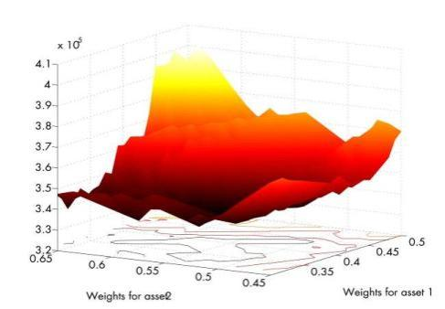
University of Geneva Develops Advanced Portfolio Optimization Techniques
Challenge
Develop and implement a general-purpose, data-driven heuristic for portfolio optimization
Solution
Use MATLAB and Parallel Computing Toolbox to develop algorithms, visualize results, and rapidly compute solutions
Results
Solutions found in minutes
Efficiency improved through visualization
Students gain practical experience
Objective function for value-at-risk minimization for a portfolio of three assets.
“For years I have said that people who use Excel or C to do advanced financial analysis are wasting their time. For any kind of numerical computation, I can’t see using anything other than MATLAB.”
- Professor Manfred Gilli, University of Geneva
Link to user story
Notes:
Primary Industry: Academia, Financial Services
Application Areas: Computational finance
Capabilities: Algorithm development, Data analysis, Parallel computing
Products Used: MATLAB, Financial Toolbox, MATLAB Distributed Computing Server, Optimization Toolbox, Parallel Computing Toolbox, Statistics and Machine Learning Toolbox
Country: Switzerland
University of Geneva Develops Advanced Portfolio Optimization Techniques
When Harry Markowitz developed a mean-variance framework for modern portfolio optimization more than 50 years ago, simplicity was a key part of its appeal. However, the adoption of more sophisticated risk measures—for example, value at risk—and constraints, including restrictions on the maximum number of different assets in a portfolio and minimum holding size, has made it all but impossible to optimize portfolios with classical techniques.
Using MATLAB®, Parallel Computing Toolbox™, and MATLAB Distributed Computing Server™, researchers at the University of Geneva have developed a multipurpose, data-driven optimization heuristic that addresses the challenges of more sophisticated risk measures and practical portfolio constraints.
"Financial analysts have been talking about downside risk for years, but few have attempted to use it for portfolio selection because the resultant optimization problem is difficult to solve," says Professor Manfred Gilli of the Department of Econometrics at the University of Geneva. "Using heuristic methods and MathWorks tools, we have developed a system that any analyst can use to arrive at optimal solutions very quickly."
The Challenge
Gilli and his colleagues sought to develop an automated system for portfolio selection using heuristics to solve complex optimization problems. Heuristic algorithms use trial-and-error methods to find solutions for mathematically complex problems. Although economists are familiar with implementing heuristic techniques, such as threshold accepting, finding a set of parameters to make algorithms work effectively is challenging.
“A financial analyst without sufficient experience with heuristic methods can waste lots of time trying to determine parameters such as the threshold sequence without a powerful analytics tool,” says Gilli, who wanted to automatically determine effective parameters for the algorithms based on the specified constraints and financial data.
As a teaching professor, Gilli also needed tools that would help students understand the concepts used in his research.
"For years I have said that people who use Excel® or C to do advanced financial analysis are wasting their time. For any kind of numerical computation, I can’t see using anything other than MATLAB.“
- Professor Manfred Gilli, University of Geneva
The Solution
Gilli and his colleagues used MATLAB, Parallel Computing Toolbox, and MATLAB Distributed Computing Server to develop and implement a threshold accepting algorithm that rapidly solves complex portfolio optimization problems involving advanced risk functions and constraints.
The group started by implementing a threshold accepting heuristic in MATLAB.
As they developed the algorithm to implement this heuristic, they relied on MATLAB graphs and plots to visualize intermediate results and understand how the algorithm was working with various data sets.
Gilli then used MATLAB to develop an application that automatically determines an effective threshold sequence based on the constraints specified and the data analyzed for a particular problem before running the optimization algorithm.
The application runs dozens of times with different starting points to find the global minimum of an optimization problem with many local minima.
A single execution of the application using this real-world data required from three to seven minutes to complete. Needing dozens of results to arrive at a solution, Gilli used MathWorks distributed computing tools to create distributed applications that execute on a computing cluster. Using the MathWorks job manager as a scheduler, Gilli executed 32 independent tasks on 32 processors in the same time required to execute the algorithm once on a single processor.
To benchmark and validate the approach, the group solved the classical Markowitz model with the heuristic. Gilli then used Optimization Toolbox™ and Financial Toolbox™ to solve the Markowitz model with a classical approach, and compared the results with the heuristic solution.
Gilli’s students use MATLAB, Optimization Toolbox, Statistics and Machine Learning Toolbox™, and Financial Toolbox to implement classical portfolio techniques and more advanced heuristic methods. He is now using the algorithm to determine the most appropriate risk measures for various market conditions.
The Results
■ Solutions found in minutes. “We frequently need to run the algorithm with 100 or more different starting points,” says Gilli. “At three to seven minutes per run, a single solution could require 11 hours or more. With Parallel Computing Toolbox, we can complete 32 runs independently on our 32 different processors, and get a solution in minutes. Parallel Computing Toolbox is perfect for this kind of problem, and it is completely scalable.”
■ Efficiency improved through visualization. “Working in MATLAB is faster and gives us a complete set of tools,” says Gilli. “In particular, the visualization capabilities of MATLAB enabled me to see intermediate results and understand what the algorithms were doing so I could make improvements.”
■ Students gain practical experience. Gilli uses MathWorks tools to teach the same concepts that he applies in his research. “My students solve heuristic optimization problems for their exams,” says Gilli. “With MATLAB, students can code their own algorithms, see how things work at a low level, and later use the existing routines from various toolboxes. I wouldn’t use anything else.”
Learn more about University of Geneva: www.unige.ch/en

Slide 13
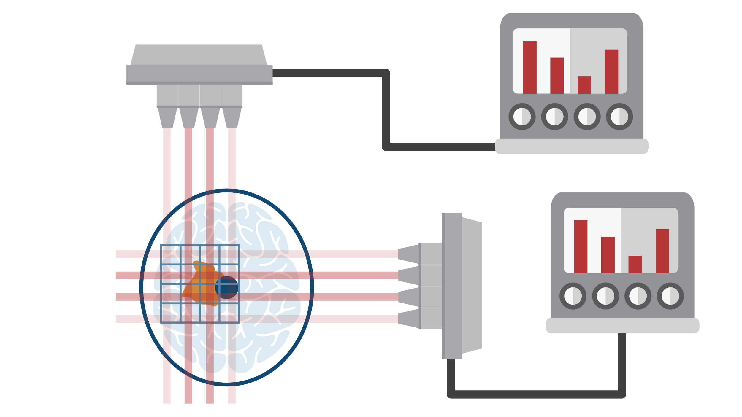
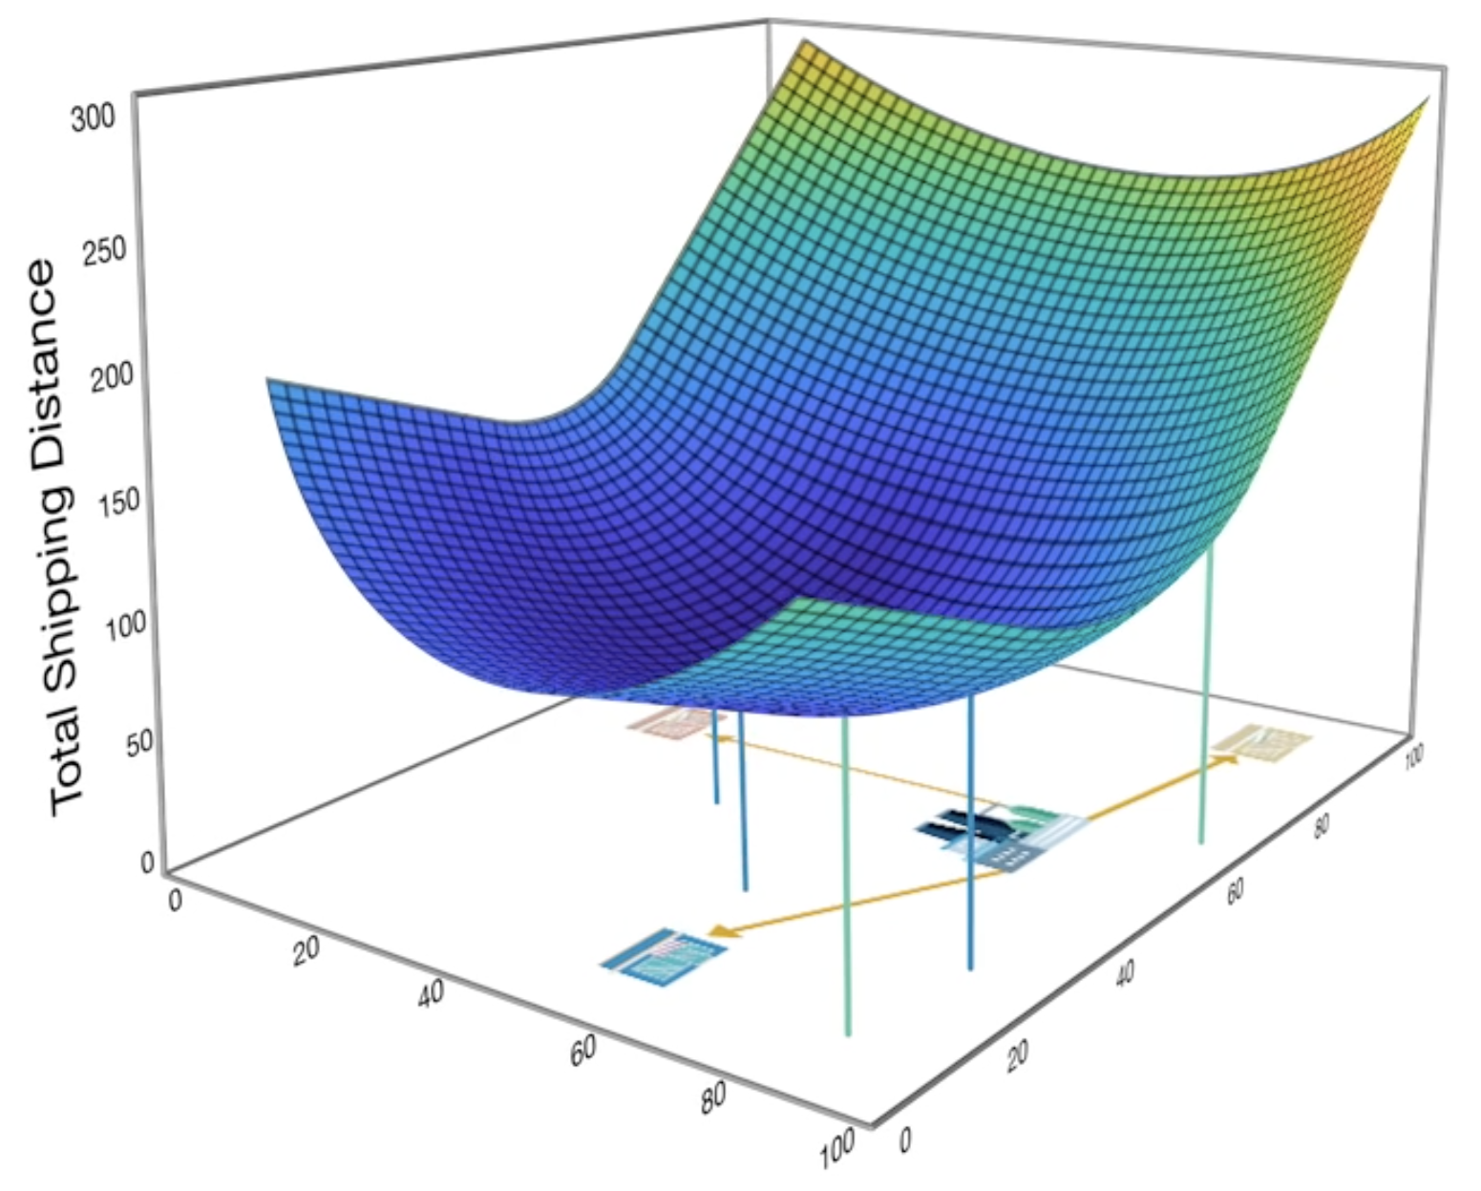
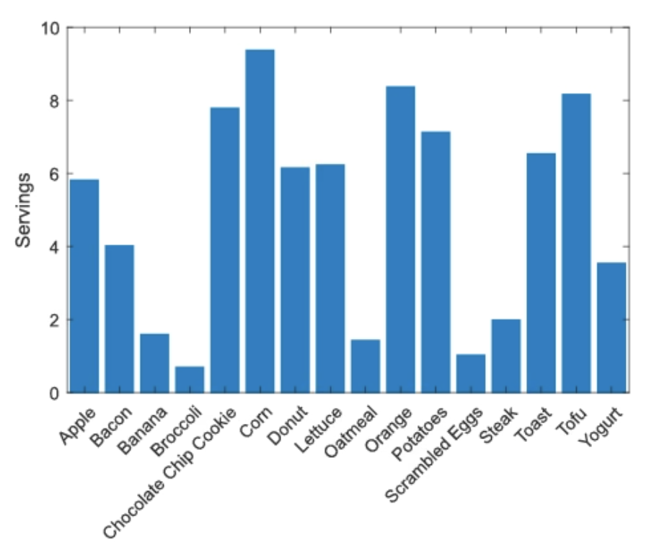

Optimization Onramp
Learn the basics of optimization in MATLAB in 2 hours
Free access to everyone
Hands-on exercises and short video demonstrations
Work through a project optimizing the delivery of radiation to a brain tumor
Topics include:
Optimization Variables
Objective Functions
Bound Constraints
Equality Constraints
Inequality Constraints

Slide 14

TO DO
Go to https://matlabacademy.mathworks.com/
Log in to your MathWorks account
Launch Optimization Onramp

Slide 15
Prizes
Complete at least 50% of Optimization Onramp to be eligible for any prize
Bring your laptop when you come to collect the prize
Follow Us on Facebook!
Find us on Facebook at [Insert Facebook Group Name]

